Slide 1
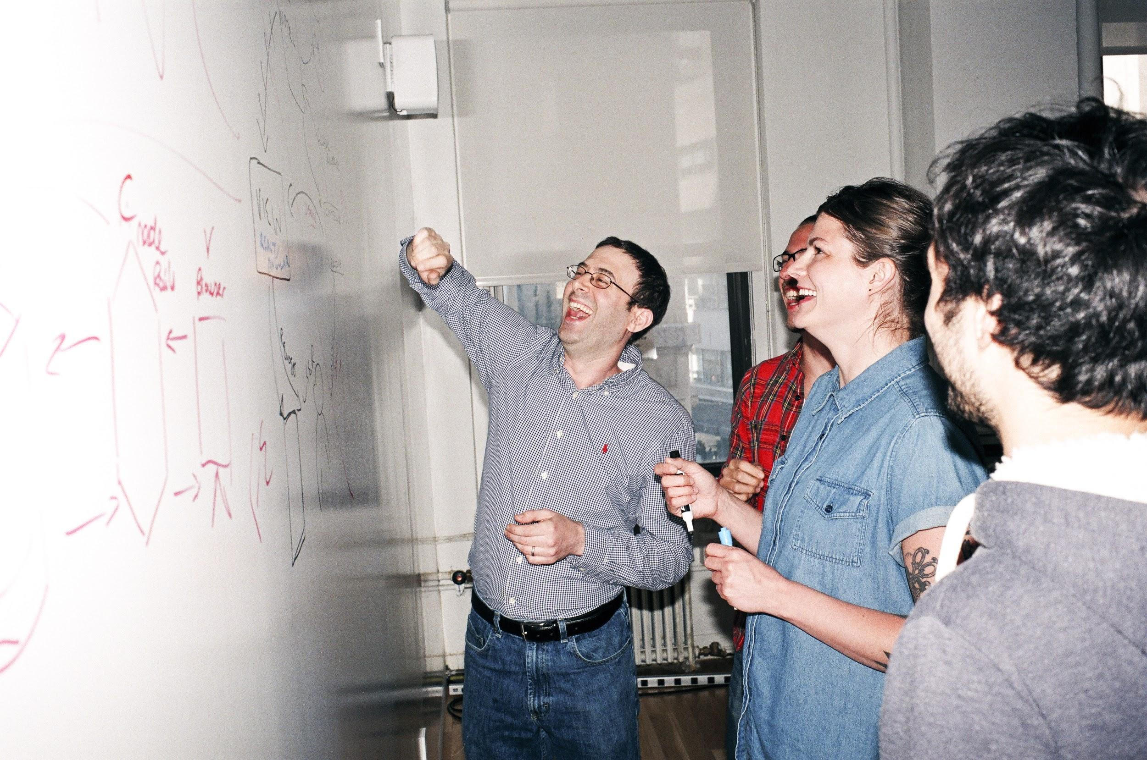

Welcome to General Assembly
WiFi GA Guest
Password yellowpencil
Notes:
[Leave this slide visible until presentation starts]

Slide 2
Course Plan

Slide 3
DATA SCIENCE
Lesson 2, Week 1
Elements of Data Science
What tasks do data scientists routinely perform, and what tools do they use?

Slide 4
Learning Objectives
By the end of this lesson you should be able to ...
Describe what data scientists create and how we get started on a problem
Use the SMART scheme for formulating the objectives of a data science problem
Describe the forms that data can take and where it may come from
Use an iPython Notebook to manipulate a dataset
Use Git to keep your local repo in sync with the course repo

Slide 5
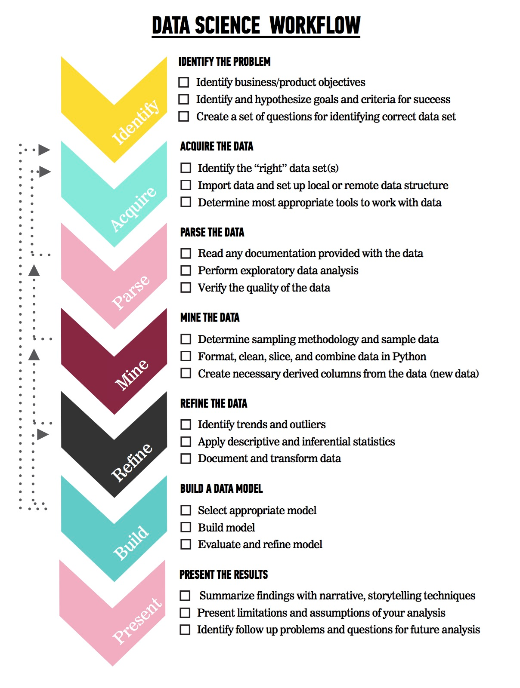
RECAP:- Data Science Workflow
The steps:
Identify the problem
Acquire the data
Parse the data
Mine the data
Refine the data
Build a data model
Present the results

Slide 6
Quick Quiz (5-mins)
Name one step in the data science workflow?
Which version of python are we using in this course?
What is the name of the online code storage platform we are using?
How do you run a code cell in jupyter notebook?
Is age a continuous or categorical variable?
Action | Unix Command |  | Action | Unix Command
Printing the working directory:
Changing directory:
Creating a new directory:
Show contents of files in directory:
Copy files

Slide 7
Quick Quiz Answers
Name one step in the data science workflow?
(Identify the problem, Acquire the data, Parse the data, Mine the data, Refine the data, Build a data model, Present the results)
Which version of python are we using in this course? (3.5, 3.6)
What is the name of the online code storage platform we are using? (github)
How do you run a code cell in jupyter notebook? (control+enter, play)
Is age a continuous or categorical variable? (Continuous)
Action | Unix Command |  | Action | Unix Command
Printing the working directory: | pwd |  | Move (rename) files: | mv
Changing directory: | cd |  | Go to “Home” directory: | cd ~
Creating a new directory: | mkdir
Show contents of files in directory: | ls
Copy files | cp

Slide 8

Let’s get started...

Slide 9


Review: Git and GitHub

Slide 10

Git and GitHub
Track files and file changes in a repository (“repo”)
version control
branching → divergent development
backup
collaboration (closed team or open source)
delivery
Most widely used version control system, largest code host
Runs from command line or a GUI (GitHub Desktop)
Repos are online

Slide 11
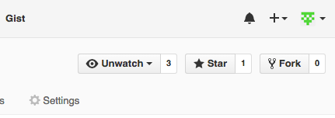
Using Git
Your Copy of the Course Repo
1. Fork
Course Repo
Master
6. Pull Request
2. Clone
5. Push
Your Laptop
Fork - make a copy of someone else’s repository on the git server.
3. Update a file
4. Commit

Slide 12
Using Git
Your Copy of the Course Repo
1. Fork
Course Repo
Master
6. Pull Request
2. Clone
5. Push
Clone copy your (forked repo) to your local machine.
Your Laptop
3. Update a file
4. Commit

Slide 13
Using Git
Your Copy of the Course Repo
1. Fork
Course Repo
Master
6. Pull Request
2. Clone
5. Push
Change make changes to code, add or remove files.
Commit make changes permanent within your cloned repo.
Your Laptop
3. Update files
4. Commit

Slide 14
Using Git
Your Copy of the Course Repo
1. Fork
Course Repo
Master
6. Pull Request
2. Clone
5. Push
Push upload changes to your online repo.
Your Laptop
3. Update files
4. Commit

Slide 15
Using Git
Your Copy of the Course Repo
1. Fork
Course Repo
Master
6. Pull Request
(Not required in this course)
2. Clone
5. Push
Pull Request invite the owner of the master repo to accept your changes.
Your Laptop
3. Update files
4. Commit

Slide 16
Course Repos (‘Fork & Pull’ Model)
https://github.com/generalassembly-studio/dat11syd.git
https://github.com/pgoodall1984/dat11syd.git
https://github.com/yourusername/yourreponame/
My local repo
TIP: Don't use your local Git repo as a working directory!
Your local repo

Slide 17
Course Repos (‘Fork & Pull’ Model)
Login!
Go here
Fork

Slide 18
Let’s get started...

Slide 19
Using the course Repo:
Navigate to the class Python Jupyter Hub:

Slide 20
Python Exercises
Python Exercises
Navigate to the class Python Jupyter Hub:
http://paulgoodall.tech:8000
Navigate to this directory
Do Lab1- Go! ☺

Slide 21
Jupyter Tips & Tricks
special commands
![cmd]
runs bash command [cmd]
‘magics’
%[cmd] "line magics"
[cmd]'s args come from same line
%%[cmd] "cellmagics"
[cmd]'s args come from entire cell
%lsmagic
lists all magics
%pwd
shows working dir
%ls -l
shows dir contents
%matplotlib inline
causes matplotlib plots to display within notebook
%%HTML
renders entire cell as HTML
use for embedding images, links, video, etc.
%%timeit
times execution of code cell

Slide 22
Now, back to Data Science ...

Slide 23
What does a data scientist do?
Michael E Driscoll:
"Data scientists are better statisticians than most programmers and better programmers than most statisticians."
DJ Patil:
"Those who use both data and science to create something new."
Allen Nugent:
“Business analysis on steroids, tackling hard challenges with big rewards, using cutting-edge computing and statistical techniques, and guided by scientific discipline.”
“Create clever, useful things that exploit data invisibly.”
“Turn data into information, and information into insight.”
actionable information
data products

Slide 24
Examples of Actionable Information
“Customers who do not place an order for 2 months and who are not subsequently contacted our Sales & Marketing are likely not to place any further orders (74% probability).”
Conversion
Sure Things
Marketing has no impact, they buy whether or not treated
Persuadable's
Marketing works, but they only buy when receiving treatment
Marketing has no effect
Marketing has effect
Lost Causes
Marketing has no impact, they do not buy whether or not treated
Do not Disturb
Marketing backfires, they do not buy when treated and do buy when left alone
No Conversion

Slide 25
Examples of Actionable Information
“The new stocking policy would increase branch inventory by $1.2M ± $0.5M, averaged over the 3 branches I modelled, with no significant increase in availability.”
“The trial changes we made to the website were accompanied by a 500% increase in visit duration (from 32 sec to over 3 minutes) and an increase in average click-through depth (from 1.8 pages to 4.7 pages). The catalog pages received 236% more hits, and sales revenue increased by 28%.”

Slide 26
Data Science Workflow Step 1:
Identify the Problem

Slide 27

Every Solution Begins with a Question
Whether we are seeking a one-off answer to a business question, a reusable information device, or a clever data product, we begin with a set of questions that frame an analysis.
By having a high quality question/aim you set yourself up for a successful analysis.
You also establish the basis for making your analysis reproducible.
A clearly articulated research question not only helps other data scientists learn from, and reproduce your work, but helps them expand on your work in the future.
“A problem well stated is half solved.” ― Charles Kettering
“Judge a man by his questions rather than by his answers.” ― Voltaire

Slide 28
“
I shall not today attempt further to define … [pornography]. But I know it when I see it.
United States Supreme Court Justice Potter Stewart, 1964

Slide 29

What is your question?
A business challenge may be vague
“How can we grow our online market share?”
Data science questions must be more focused
“Is our website engaging?”
“Are we presenting our products effectively to website visitors?”
“Are our prices competitive?”
“Is this market niche saturated?”
Even these examples are a bit vague, but we could easily break them down into quantitative questions
What is your quest? What is your favourite colour?
What is the average airspeed of an unladen sparrow?

Slide 30
Applying the Data Science Workflow:
What makes a good question?
Specific | The dataset and key variables are clearly defined.
Measurable | The type of analysis and major assumptions are articulated.
Attainable | The available data are amenable to the question and unlikely to be biased.
Reproducible | The analysis can be repeated by another person or at another time.
Time-bound | The time period and population to which the analysis pertains is clearly stated.

Slide 31
Knowledge Check
Does this question follow the SMART framework?
“Is there an association between number of passengers with carry-on luggage and delayed take-off time?”

Slide 32
Knowledge Check
How about the revised question?
“Is there an association between number of passengers with carry-on luggage and delayed take-off time?”
“Is there an association between the number of passengers (on JetBlue, Delta, and United domestic flights) with carry-on luggage and delayed take-off time in the data from flightstats.com between January 2015 and December 2015.”

Slide 33
Let’s get practical
Variable | Definition | Key
Survived | survival | 0 = No, 1 = Yes
Pclass | ticket class | 1 = 1st, 2 = 2nd, 3 = 3rd
Name | name
Sex | sex
Age | age in years
Sibsp | # of siblings, spouses aboard
Parch | # of parents, children aboard
Ticket | ticket number
Fare | passenger fare
Cabin | cabin number
Embarked | port of embarkation
Work in groups of 3-4
Dataset: Survivors of the Titanic
https://www.kaggle.com/c/titanic/data
dataset
data dictionary
Formulate a question you could ask of this dataset, abiding by the SMART framework
Elect a spokesman to present your proposal

Slide 34
Let’s get practical
Example Answers:
“Using data from April 15, 1912, taken from the Titanic disaster, we will determine the association of gender and age (in years) with survival.”
“Using data from April 15, 1912, taken from the Titanic disaster, we will test the hypothesis that women and children were preferentially given places in lifeboats by analysing relative survival rates of men, women, and children.”

Slide 35
Questions?

Slide 36
Let’s get started...

Slide 37
Python Exercises
Python Exercises
Navigate to the class Python Jupyter Hub:
http://paulgoodall.tech:8000
Navigate to this directory
Do Lab2- Go! ☺

Slide 38
Data Science Workflow Step 2:
Acquire the Data

Slide 39
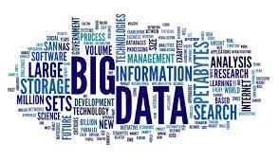



Data Sources
databases (SQL, JSON, etc.)
electronic files (CSV, TXT, XML, JSON)
Web pages (HTML, XML, Google Analytics)
surveys
published datasets
social media (TXT, JSON)
documents (PDF, JPEG, etc.)
measurements
experiments, QA
devices & monitors (ASCII, binary)
sensors, meters, loggers
trackers, wearables

Slide 40
Data Temporality
Cross-sectional (‘static’)
treated as a snapshot in time
causality is simultaneous
Longitudinal (‘time series’) Yearly vs Monthly
treated as a series of snapshots with a temporal or serial dependence
Dynamic (‘streaming’)
continuously accumulated or refreshed

Slide 41
Dataset Characteristics
size
completeness
bias
accuracy, precision
periodicity
stationarity
variance, heteroskedasticity
correlated variables
causation or covariation
correlated samples
time series / Markov series
contaminated or prejudiced sampling

Slide 42
The Null Hypothesis
Practical example
Suppose we have a dataset comprised of patients’ responses to two different therapies:
drug A (the old drug, or ‘control’ treatment)
drug B (the new drug, or ‘test’ treatment).
The null hypothesis H₀ assumes that there is no significant difference between the two. In statistical terms, this means that the two distributions we get from the ‘A’ data and the ‘B’ data represent two sample sets from the same ‘population’ (i.e. a common underlying distribution).

Slide 43
What does that prove?!
To prove that ‘B’ is better than ‘A’ we must, we need to make a convincing case that the true mean value of the ‘B’ data is different from that of ‘A’ (and in a favourable sense):
we are trying to show that we can safely reject H₀
Thus, we must demonstrate that the probability that the ‘A’ and ’B’ distributions are samples of the same population is less than some threshold (usually P < 0.05).
Note that we can’t really prove that ‘B’ is better than ‘A’, because there is always a finite chance that one or both of our sample sets is highly unrepresentative of its respective population.

Slide 44
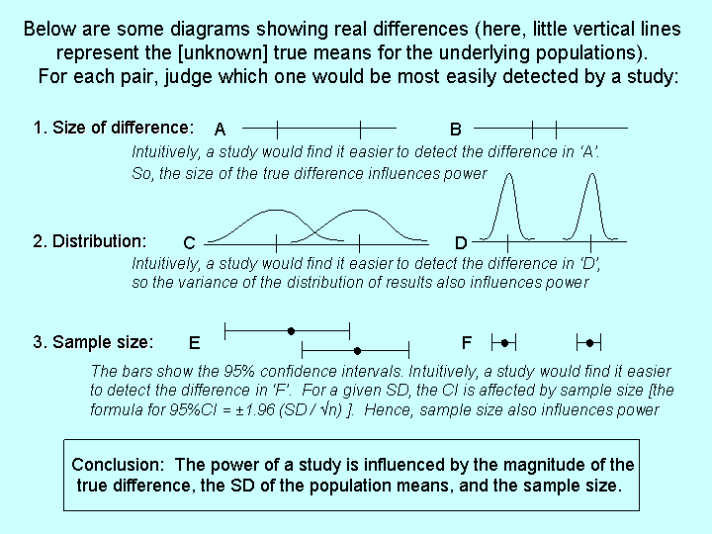
How Much Data is Enough?
Statistical power:
The probability that we will correctly reject H₀
www.med.uottawa.ca

Slide 45
Questions?

Slide 46
Let’s get started...

Slide 47
Python Exercises
Python Exercises
Navigate to the class Python Jupyter Hub:
http://paulgoodall.tech:8000
Navigate to this directory
Do Lab3- Go! ☺

Slide 48
Data Science Workflow Step 3:
Parse the Data

Slide 49
Data Types
Numeric | Text | Other
integer signed, unsigned 2, 4 B | character 1 B (ASCII) 2 B (unicode) | Boolean true, false Binary 2^{n}
floating-point (‘float’) 4, 8 B double = 2 x float | string character array 0-based or 1-based null-terminated or length-encoded usually immutable in OOP | unassigned null NA undefined NA +, − infinity
complex 2 x double (real, imaginary) | document key-value pairs (JSON strings) | BLOB images, video signals

Slide 50
Numeric Data Representation
Name | Symbol | Limits | Where
binary |  | base 2 range = 2 | ubiquitous
octal | \123 | base 8 range = 256 | early digital computers
decimal |  | base 10 | ubiquitous
12-bit |  | base 10 range = 4096 | microcontrollers, analog-to-digital converters
hexadecimal | \x123, 123h | base 16 range = 65,536 | modern digital computers

Slide 51
Data Types in Python and NumPy
Type | Python | Numpy | Usage
byte byte array | b‘any string’ bytearray() |  | immutable mutable
integer | int() | 11 types | signed, unsigned 8, 16, 32, 64 bits, unlimited
floating-point | float() | 3 types | 16, 32, 64 bits
complex | complex() | 2 types | 64, 128 bits
unassigned | None |  | object myVar is not None
missing | nan | isnull(), notnull(), isnan() | float, object

Slide 52
Data Forensics
Outputs
Inputs
Outcomes
Dependent Variables
Responses
Features
Independent Variables
Predictors
A covariate is a variable that is possibly predictive of the response. It could also represent an interacting variable.
A predictor is a feature that is useful in modelling the response. Specifically, its inclusion enables a model to account for more of the variance of the response.
A confounding variable is one which influences the response but has not been measured (i.e. it introduces bias).

Slide 53
Tidy Data
The end goal of the cleaning data process:
each variable should be in one column
each observation should comprise one row
each type of observational unit should form one table
key columns for linking multiple tables
top row contains (sensible) variable names
in general, save data as one file per table
search: “hadley wickham's tidy data paper”
Codd’s 3rd normal form

Slide 54
Is this Tidy Data?
 | treatment.A | treatment.B
patient.1 | ₋ | 2
patient.2 | 16 | 11
patient.3 | 3 | 1

Slide 55
How about this?
Patient | Treatment | NumEvents
1 | A | 0
1 | B | 2
2 | A | 16
2 | B | 11
3 | A | 3
3 | B | 1
ASSUMPTION: “-” means zero
could mean ‘missing’!

Slide 56

Review

Slide 57
Review: Key Topics and Takeaways
Data Science Workflow Step 1: ______
?

Slide 58
Review: Key Topics and Takeaways
Data Science Workflow Step 1: Identify
SMART

Slide 59
Review: Key Topics and Takeaways
Data Science Workflow Step 2: ______
?
?
?
?

Slide 60
Review: Key Topics and Takeaways
Data Science Workflow Step 2: Acquire
data sources
temporality
dataset characteristics
statistical significance & the null hypothesis

Slide 61
Review: Key Topics and Takeaways
Data Science Workflow Step 3: _____
?
?
?
?

Slide 62
Review: Key Topics and Takeaways
Data Science Workflow Step 3: Parse
data types
data forensics
tidy data
NumPy, Pandas

Slide 63

Q&A

Slide 65
Additional Resources
Statistics tutorials:
http://stattrek.com/tutorials/statistics-tutorial.aspx
NumPy reference:
https://docs.scipy.org/doc/numpy-1.13.0/reference/
GitHub:
https://guides.github.com/introduction/flow/

Slide 66
Please don’t forget the survey!
Exit Tickets:
https://docs.google.com/forms/d/e/1FAIpQLSdaBdMebhoXQpac2edDbIkHD-78HrTpBk3VKGH6lcDMVorSIQ/viewform

Slide 67

Thank You!

Slide 68
Using Git
Your Copy of the Course Repo
1. Fork
Course Repo
Master
6. Pull Request
2. Clone
5. Push
Your Laptop
Fork - make a copy of someone else’s repository on the git server.
3. Update a file
4. Commit

Slide 69
Using Git
Your Copy of the Course Repo
1. Fork
Course Repo
Master
6. Pull Request
2. Clone
5. Push
Clone copy your (forked repo) to your local machine.
Your Laptop
3. Update a file
4. Commit

Slide 70
Using Git
Your Copy of the Course Repo
1. Fork
Course Repo
Master
6. Pull Request
2. Clone
5. Push
Change make changes to code, add or remove files.
Commit make changes permanent within your cloned repo.
Your Laptop
3. Update files
4. Commit

Slide 71
Using Git
Your Copy of the Course Repo
1. Fork
Course Repo
Master
6. Pull Request
2. Clone
5. Push
Push upload changes to your online repo.
Your Laptop
3. Update files
4. Commit

Slide 72
Using Git
Your Copy of the Course Repo
1. Fork
Course Repo
Master
6. Pull Request
(Not required in this course)
2. Clone
5. Push
Pull Request invite the owner of the master repo to accept your changes.
Your Laptop
3. Update files
4. Commit

Slide 73
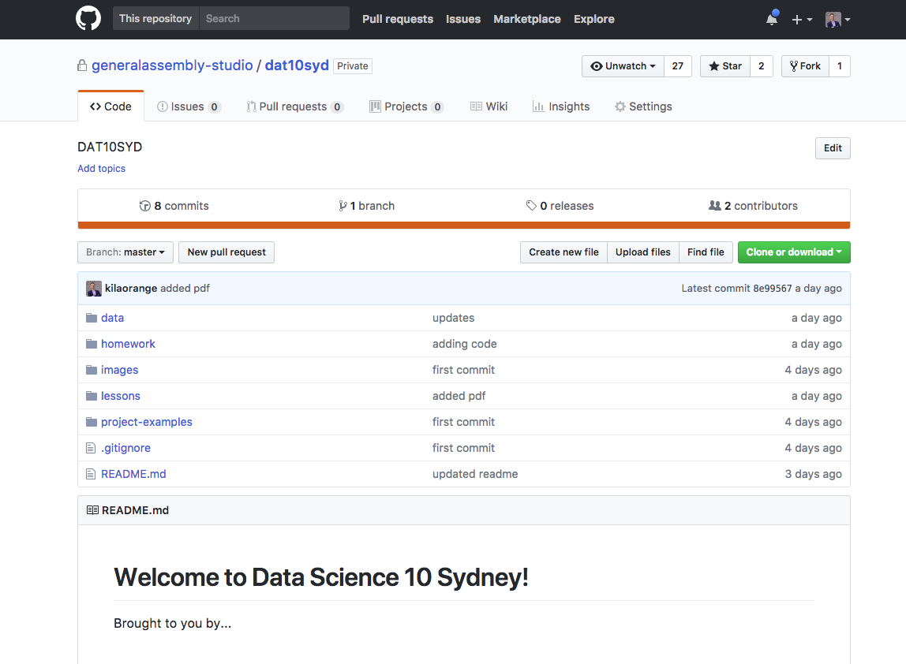
Preparing and Using Your Local Git
Improve on Tuesday night: delete Repo we cloned on Tuesday
Fork the GA Repo https://github.com/generalassembly-studio/dat10syd.git

Slide 74
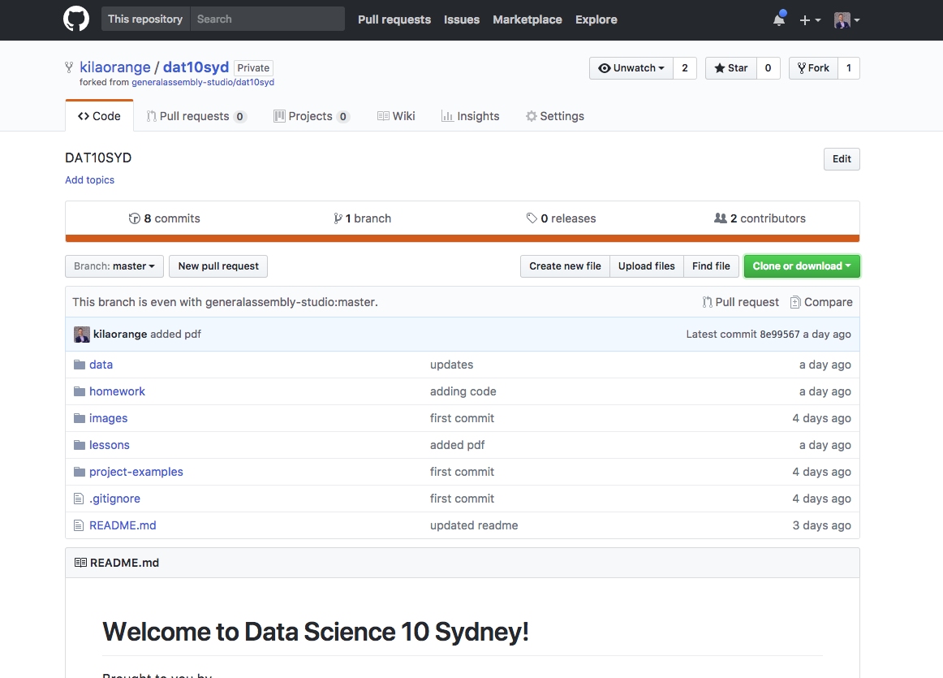
Preparing and Using Your Local Git
It now looks like this…
Copy text

Slide 75
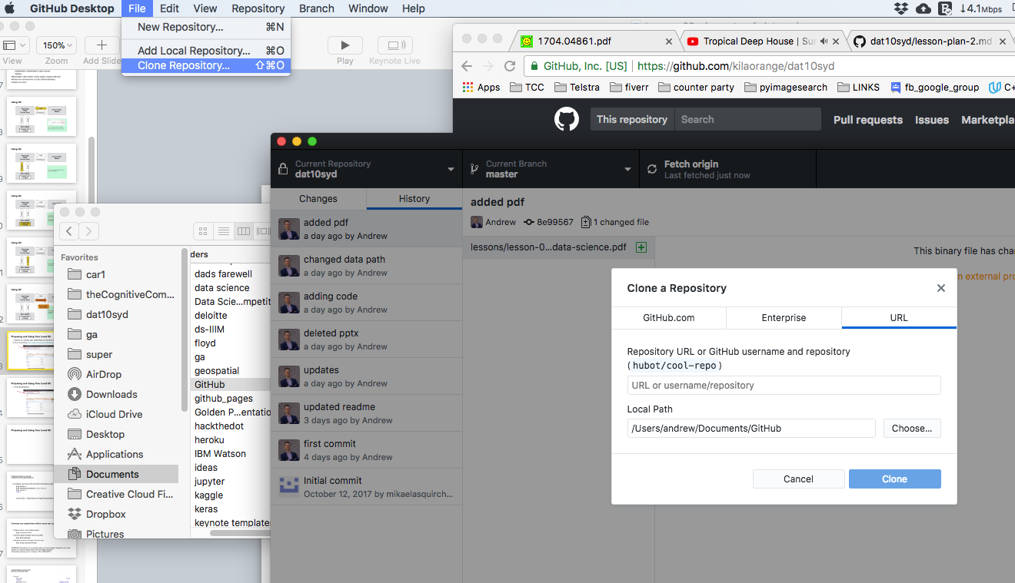
Preparing and Using Your Local Git

Slide 76
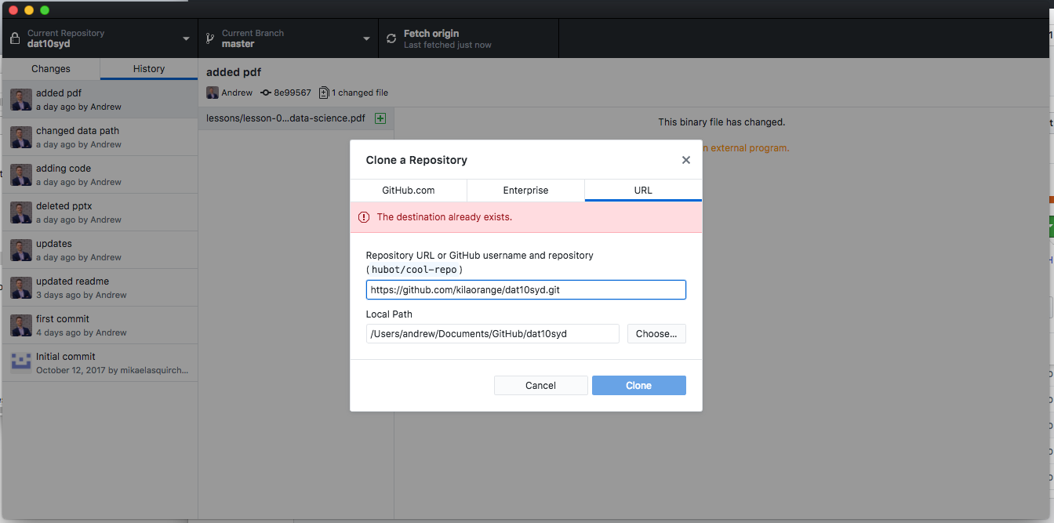
Preparing and Using Your Local Git
Copied two slides back
Clone

Slide 77
Preparing and Using Your Local Git
Fork the master repo to your GitHub account
Open a terminal (Mac, Linux) or git bash (Windows)
Change working directory to where you want the local repo
$ cd yourpath
Clone
$ git clone https://github.com/yourgithubname/yourgithubrepo

Slide 78
Preparing and Using Your Local Git
Fork the master repo to your GitHub account
Open a terminal (Mac, Linux) or git bash (Windows)
Change working directory to where you want the local repo
$ cd yourpath
Clone
$ git clone https://github.com/yourgithubname/yourgithubrepo

Slide 79
Preparing and Using Your Local Git:
Configure Automatic Updates (Optional)
Configure your local clone to point to the official course repository
$ git remote -v $ git remote add upstream course-repo.git $ git remote -v # check
course-repo = ‘https://github.com/generalassembly-studio/dat9syd’

Slide 80
Download new material from official course repo (upstream) and merge it
Ensure you’re in the master branch
$ git checkout master
Grab the latest changes from the master
$ git fetch upstream
Merge the master changes with your repo
$ git merge upstream/master
WARNING: Be careful not to overwrite files you have already changed in your repo unless you want to replace them with the master versions! (Consider renaming yours or doing a PULL REQUEST.)

Slide 81
Commit Changes to Your Local Git and Push to Your Master Repo
Commit
$ git status # show changes
$ git add filename # stages one file
$ git add . # stages all changed files
$ git commit -m your comments # commits file(s), with comments
$ git status # check
Push
$ git push origin master # push request auto accepted
origin = your GitHub repo (forked from course repo) master = course repo

